Slide 1

Introduction to Agile Web Development
CITS3403 and CITS5505 - Agile Web Development
Unit Coordinator: Matthew Daggitt
2024, Semester 1
Notes:
1

Slide 2




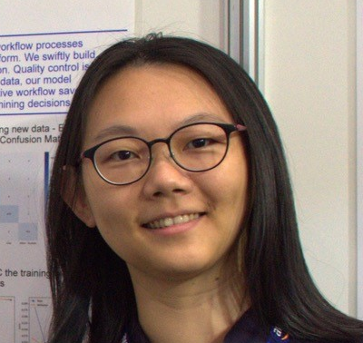

Unit Information
People:
Unit links:
LMS: https://lms.uwa.edu.au/
Help forum: Microsoft Teams
Unit Coordinator
Matthew Daggitt
Lab facilitator
Lauren Gee
Lab facilitator
Pascal Sun
Lab facilitator
Aline de Souza Andrade
Lab facilitator
Huixin Yang
Lab facilitator
Tin Chi Pang
Notes:
2

Slide 3
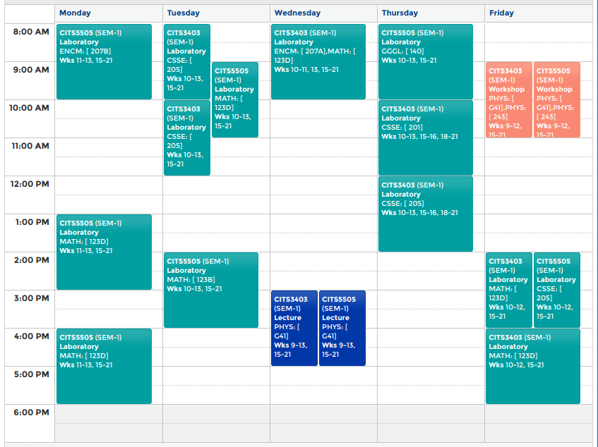
Weekly timetabling
Office hours
Rm 2.14 CS
&
MS Teams
3
Notes:
3

Slide 4


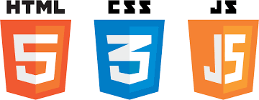
Welcome to Agile Web Development
Focus on programming for the WWW and agile software development.
Content summary:
How the web works
Markup languages and protocols
Web Styling with CSS and Bootstrap
Document object models and event handling
Client-side scripting with JavaScript, jQuery and AJAX
Flask Python web application development
Agile development and GIT
MVC architecture and object relational modelling
Deployment
REST APIs
We use open source and free technologies
You can use it at home!
4
Notes:
4

Slide 5
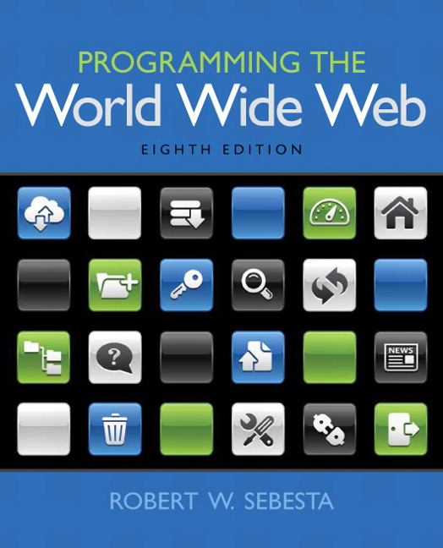
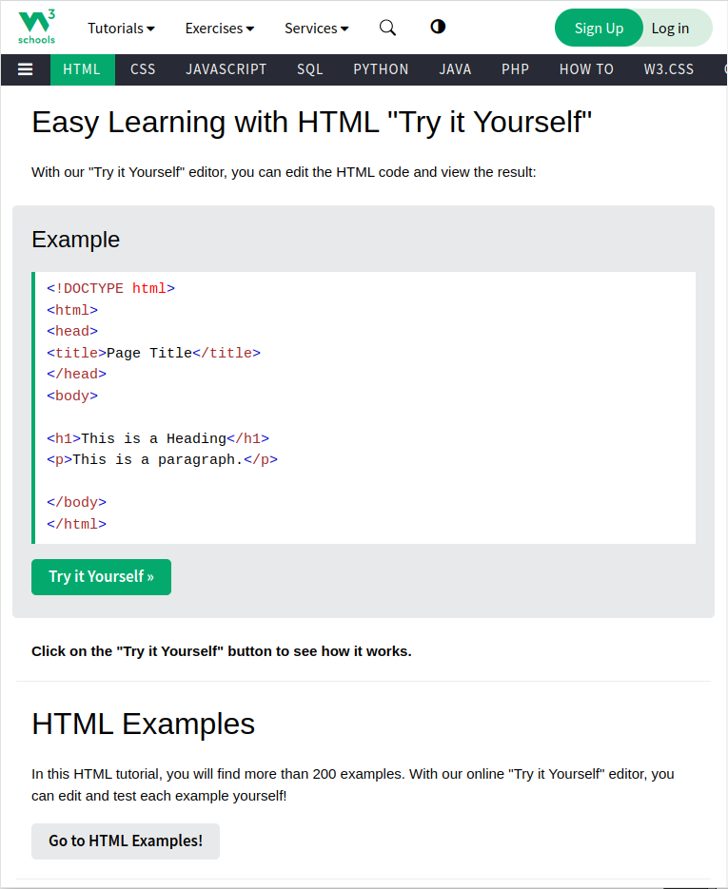


Recommended Reading
General references
Lab material
Robert W. Sebesta, Programming the World Wide Web 2015, 8th Edition, Pearson/Addison Wesley.
Part I
W3Schools
https://www.w3schools.com
Miguel Grinberg, Flask Web Development, 2nd Edition, O’Rielly, 2018
Part II
Miguel Grinberg
Flask Mega-Tutorial
https://blog.miguelgrinberg.com/post/the-flask-mega-tutorial-part-i-hello-world
Notes:
5

Slide 6
Assessment
CITS5505 Project 1: Due Monday April 15, 5pm
10% of final grade
Write a basic web page, with researched content
CITS3403 Mid-semester test: Friday April 5, 9am LMS Online.
10% or final grade
< 10 questions, written answers, 60 minutes
CITS3403/5505 Project: Sunday, May 19, 5pm.
40% of final grade
Done in groups of 4
Build a request board application. Lab work will step through this process.
CITS3403/5505 Written final exam: exam period
50% of final grade
Please ensure you have consulted the Unit Outline for information on:
unsatisfactory progress
late assessment penalties
plagiarism and AI tools policy
including ACE and academic misconduct
faculty marks adjustment policy
6
Notes:
6

Slide 7
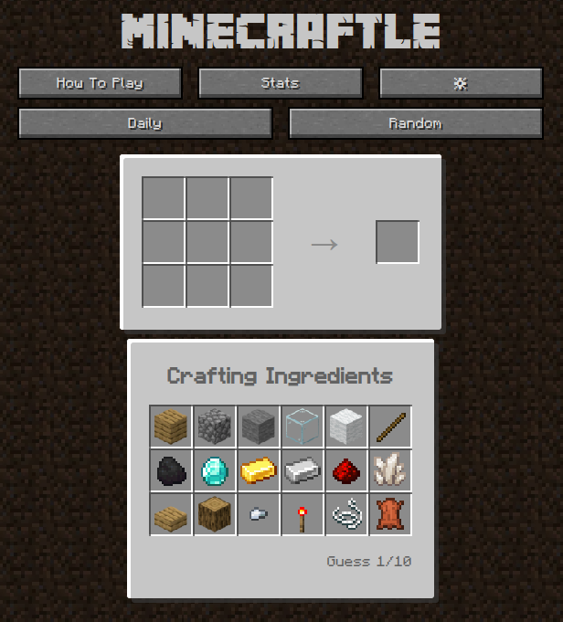
A project success story
Email received on February 26th 2024...
I took CITS3403 in 2022 semester 1, it was one of the best units in the whole degree. For the final project we built Minecraftle which was wordle + minecraft crafting recipes. When we completed the project, we deployed it online using a small server. Since the unit finished, I gave it a few more updates to fix bugs and forgot about it.
Near the end of last year someone on YouTube started making videos of the game and it has since become quite popular. As of yesterday, it just hit 1 million players! The game has contributed to getting a software engineering job in Melbourne that I started in January.
https://github.com/zachpmanson/minecraftle/
https://minecraftle.zachmanson.com/

Slide 8
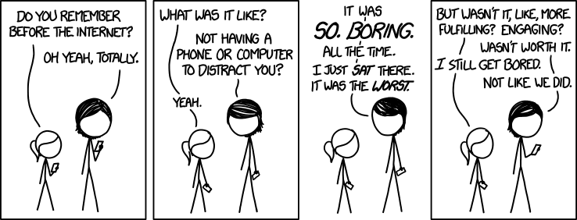
A (very) brief history of the Internet
https://xkcd.com/1348/
Notes:
8

Slide 9
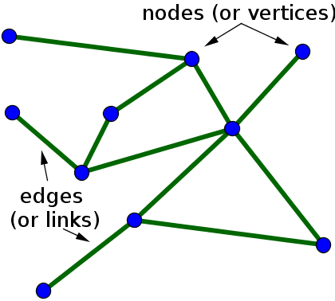
What is a computer network?
A network is a structure linking devices together for the purpose of communication and can be modelled as a graph.
Each individual device is modelled as a node in the graph.
The physical connection between two devices is modelled as an edge in the graph.
Notes:
9

Slide 10
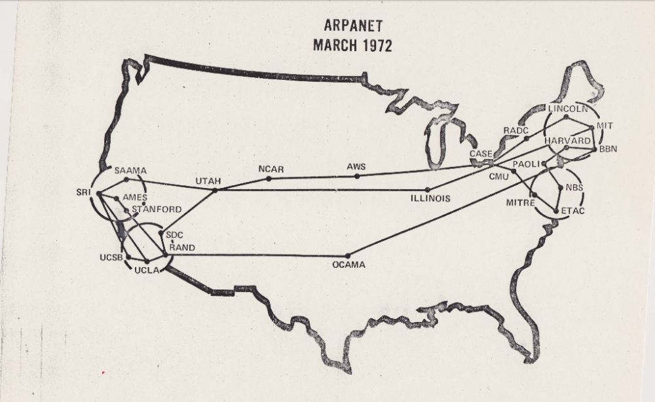
Networks before the Internet
In the US, the DoD created the Advanced Research Projects Agency (ARPA, now DARPA) in 1958. ARPA was interested in creating networks that:
allowed communications, program sharing, remote computer access
were robust and would continue to work if some nodes “taken out” by malicious forces
This resulted in the ARPAnet in the late 1960s and early 1970s
linked about a dozen ARPA-funded research labs and universities
graduate students played a large part in its development!
didn’t live up to intentions - mostly text-based email and limited reach.
but still useful and the snowball had started to roll…
Non-ARPA-funded Universities wanted in, so other networks
were created in the late 70s and early 80s
BITnet (Because It’s Time Network), initially electronic
mail and file transfer
CSnet (Computer Science Network), primarily email
Notes:
10

Slide 11
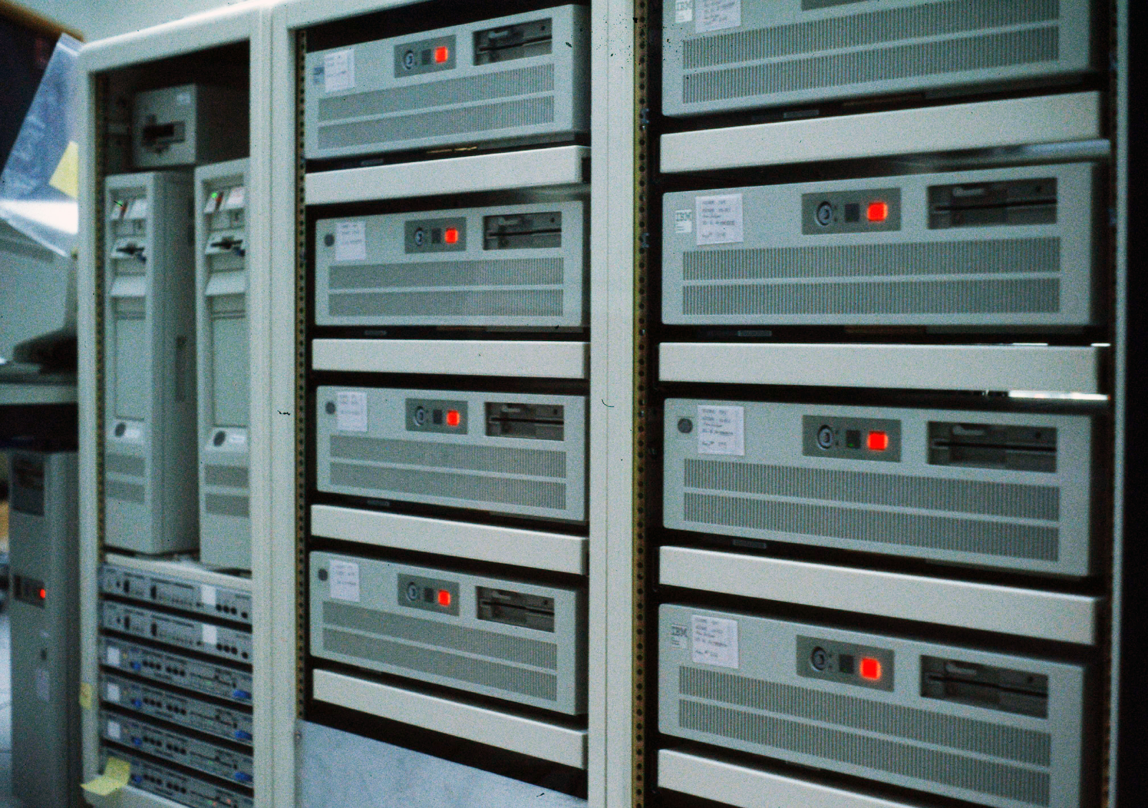
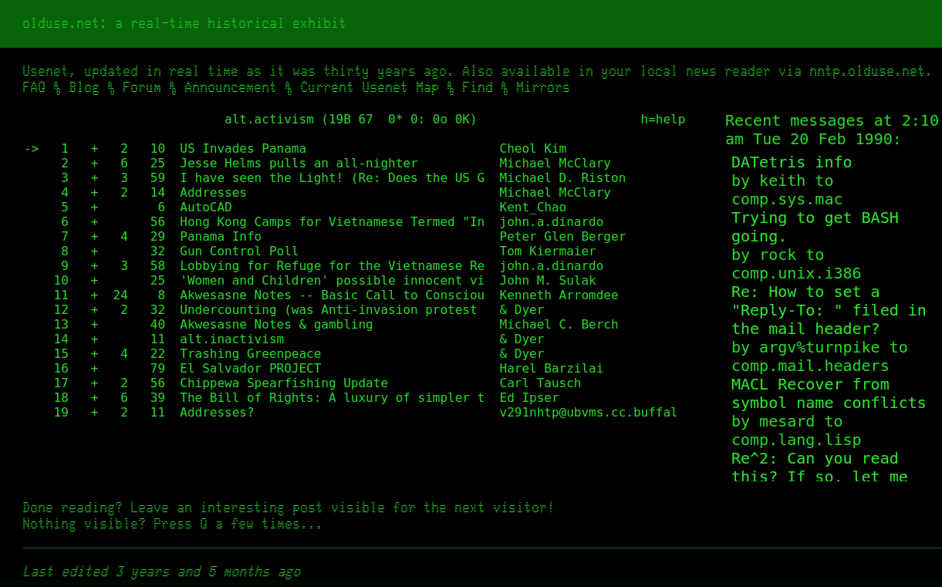
The Birth of the Internet
NSFnet was created in 1986 by the National Science Foundation (NSF).
Originally for non-DoD funded places, and initially connected five supercomputer centres but quickly spread to other academic institutions and research labs.
By 1988/89 - commercial infiltration - mail, ISPs.
By 1990, it had replaced ARPAnet for non-military uses and it soon became the network for everyone.
Other networks created gateways and eventually merged with NSFNet (e.g. JANET, BITnet, Usenet, …).
By 1992 connected more than 1 million computers around the world and eventually became known as "the Internet".
Notes:
11

Slide 12
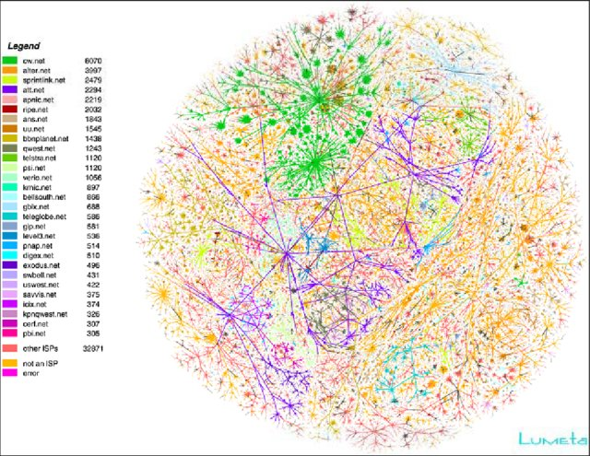
The Evolution of the Internet
The Internet is still a network of interconnected networks.
As it evolved high-speed backbone links were created to carry large amounts of data.
Smaller networks connect to the backbone, enabling any user on any network to exchange data with any other user.
Both backbone links and individual networks can be owned by companies, universities or nation states.
It achieved ARPA's original goal that if part of its infrastructure is destroyed, data can still flow through the remaining networks (in principle).
By the 2000s it had become indispensable global infrastructure.
Notes:
12

Slide 13
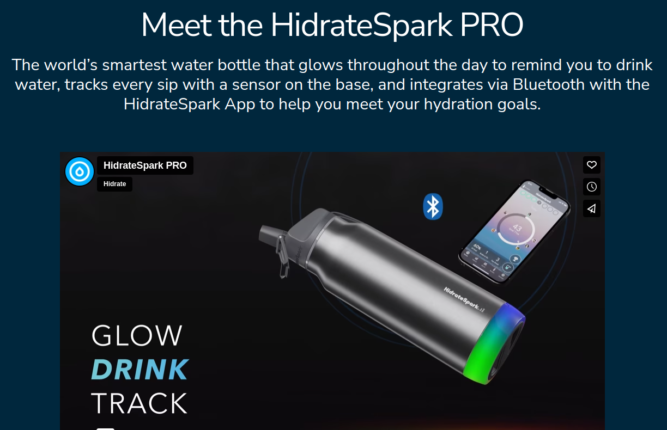
The Internet Today
Today the Internet has grown to include tens of billions of interconnected computers, smart phones, televisions, printers, fridges, watches and most crucially... water bottles.
All these devices on the Internet are connected using a wide range of different types of links: copper cables, fibre-optic cables, satellites, phone lines etc.
Notes:
13

Slide 14
How does the internet work?
Notes:
14

Slide 15
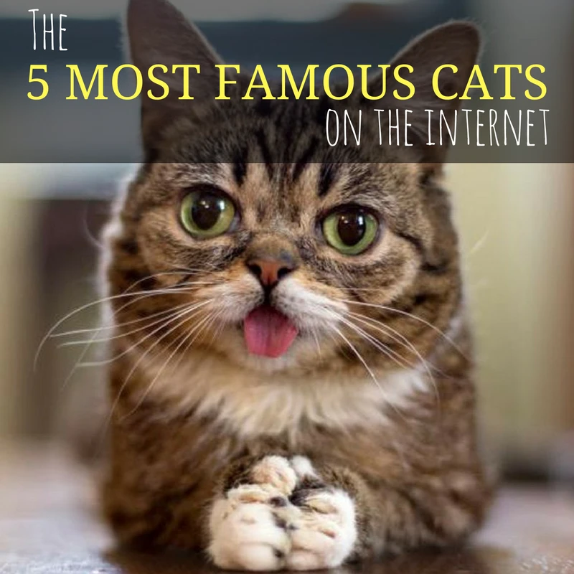
Communication protocols
No matter whether using fibre-optics, satellite links etc, the physical connections all send data as a sequence of bits, e.g. 10101111011010000011001.
Network communication is possible only if computers “speak” a common language and know how to interpret the bits. These common languages are known as protocols.
It's protocols all the way down:
IP – consistent addressing of entities on the internet
BGP – finding the best routes across the internet
TCP – error-free delivery of streams of data
SMTP – sending and receiving emails.
FTP – sending and receiving files.
etc. etc.
Notes:
15

Slide 16
The TCP/IP model
Every computer and network on the Internet uses the same set of protocols - the Transmission Control Protocol/Internet Protocol, or TCP/IP for short.
No matter what type of computer system you connect to the Internet, if it uses TCP/IP, it can exchange data with any other type of computer.
TCP/IP was developed to tolerate unreliable sub-networks and the protocol guarantees proper transmission of data, since the physical network can’t.
For transmission not needing guarantees, one can use User Datagram Protocol (UDP) instead of TCP. Data transmitted by UDP arrive faster, with none of the error detection or correction overheads that are in TCP/IP.
In TCP/IP a stream of data is split into packets which are sent individually over the network.
Notes:
16

Slide 17
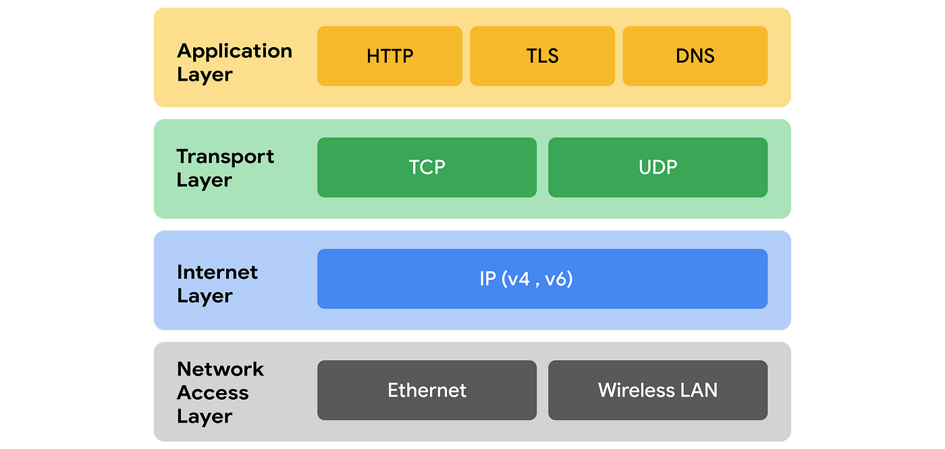
The TCP/IP model layers
The TCP/IP model is split up into four layers:
The application layer protocols dictate what format the stream of data should be in for different high-level applications.
The transport layer protocols convert the stream of data to and from a sequence of packets and are responsible for detecting and fixing packets that are lost or corrupted during transport.
The internet layer protocols are responsible for transmitting a single packet from the source device to the destination device across the network.
The network access layer protocols describe how a single packet is transmitted across a single physical link in the network.
Notes:
17

Slide 18
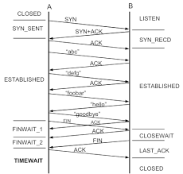
Communication protocols
The rules and procedures for controlling timing and data format are the protocols and they,
signal another computer requesting communication. (client)
identify the requesting computer. (server)
transmit messages in blocks. (server)
retransmit if messages fail to arrive. (server)
detect errors and recovers. (client)
signal transmission is complete. (client)
terminate the connection. (server)
Notes:
18

Slide 19
Client-Server Architecture
Most communication on the internet takes the form of a client-server relationship.
The server is computer whose address is known, and which stores information on its file system.
The clients sends a request for information to the server via an agreed protocol (FTP, SMTP etc.).
The server transmits the requested information back to the clients.
Advantages
Multiple clients can use a single server.
New clients can join the system without having to be registered in advance.
We have a single, central source of information.
Disadvantages:
There is a single point of failure – the server.
If too many clients, the server may be overloaded with requests.
To get around the disadvantages, we can have many duplicate servers containing the same content, at the cost that more work must be done to keep the copies of information synchronised...
Notes:
19

Slide 20
Internet Applications
Notes:
20

Slide 21
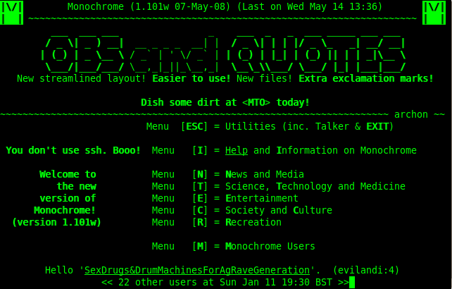
Bulletin Board System (BBS)
Early interactive software, late 1970s to 1980s
Users could login to:
exchange messages through mail or public message boards
read news and bulletins
upload/download software
even on-line games
accessed using modem and phone line
precursor to today’s WWW
http://en.wikipedia.org/wiki/File:Monochrome-bbs.png
Notes:
21

Slide 22
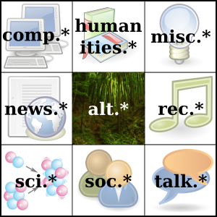
Usenet
Idea conceived by Duke University grad students in 1979
Unlike BBS, distributed network of servers (e.g. each university)
Large number of forums called newsgroups (not just news - users posts)
Threaded discussions
Formed social communities
Precursor to Internet forums
Source: Benjamin D. Esham, Wikimedia Commons http://en.wikipedia.org/wiki/File:Usenet_Big_Nine.svg
Notes:
22

Slide 23
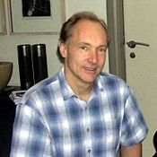
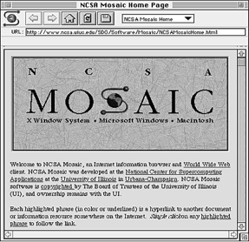
The "killer app" - the World Wide Web
Early internet was mainly used by people in universities and research labs.
Lots of information but very difficult to access.
Needed the IP address of the computer you wanted to connect to.
No uniform way of visualising the information.
In 1991, CERN publicised new World Wide Web project, invented earlier by Tim Berners-Lee and colleagues in 1989:
DNS (Domain Name System) resolves URLs (names) to IP addresses.
Included the first browser "WorldWideWeb" on the NeXTSTEP platform
First ever website still online!
In 1993, the National Center for Supercomputing Applications (NCSA) at the University of Illinois released v1.0 of Mosaic browser:
written by a student, Marc Andreessen, and Eric Bina
first multimedia browser (mixed images and text)!
Explosion in internet use!
growth of web usage in 1000s of percent
changed internet use forever
the “killer app” of the 90s
???
Notes:
23

Slide 24
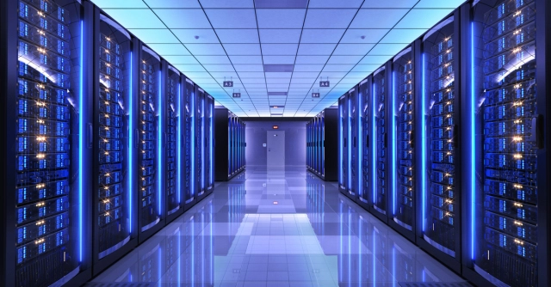
Client-server Architecture of the Web
Communication is by an agreed protocol, e.g. the HTTP (HyperText Transfer Protocol).
The user requests a web page through the browser, a program running locally on their computer.
The browser, as the client, locates the correct server and communicates the request.
The server retrieves the web page from its local file system and transmits the files back to the browser.
The browser receives the files, (usually text file containing HTML instructions) and uses them to render the web page resulting in the intricate graphics and formatting you see on your screen.
Notes:
24

Slide 25
A URL (uniform resource locator)
http://www.domain.edu.au:1000/path/to/file?parameters=true#fragment
The protocol used. Typically, http, ftp, https, …
The domain name. A domain name server maps this to an IP address
The port number. Servers have ports 0-65535, but http defaults to port 80.
The path (route) to the file to execute. The file is typically an HTML file, but it could also be PHP, text, PDF.
The parameters of the request. These are specified as a set of key value pairs.
The fragment. This anchors to a location in a page.
There are also hidden parts of the request including the browser name and cookies.
Notes:
25

Slide 26

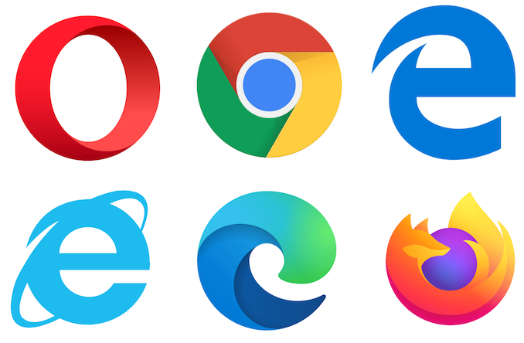
The World Wide Web today
The world wide web is essentially the fragment of the internet accessible through web browsers.
It is a unique engineering environment with obscure ownership and control.
Arguably the most impressive piece of infrastructure ever built by humanity.
Hundreds of standards have evolved that define interaction over the webpages.
As search has come to dominate, URLs are becoming less relevant to users.
Notes:
26

Slide 27
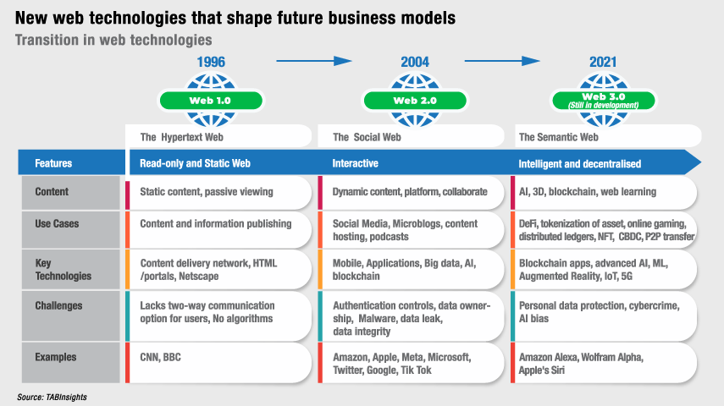
The World Wide Web tomorrow
, ChatGPT, Bard, …
Notes:
27

